Slide 1
Experimental Evaluation
In experimental Machine Learning we evaluate the accuracy of a
hypothesis empirically.
This raises a few important methodological questions:

Slide 2
Experimental Evaluation
In experimental Machine Learning we evaluate the accuracy of a
hypothesis empirically.
This raises a few important methodological questions:
Given the observed accuracy of the hypothesis over a limited sample of
data, how well does it estimate its accuracy over additional examples ?

Slide 3
Experimental Evaluation
In experimental Machine Learning we evaluate the accuracy of a
hypothesis empirically.
This raises a few important methodological questions:
Given the observed accuracy of the hypothesis over a limited sample of
data, how well does it estimate its accuracy over additional examples ?
Given that one hypothesis outperforms another over some sample of
data, how probable is it that it is more accurate in general ?

Slide 4
Experimental Evaluation
In experimental Machine Learning we evaluate the accuracy of a
hypothesis empirically.
This raises a few important methodological questions:
Given the observed accuracy of the hypothesis over a limited sample of
data, how well does it estimate its accuracy over additional examples ?
Given that one hypothesis outperforms another over some sample of
data, how probable is it that it is more accurate in general ?
When data is limited, what is the best way to use this data to both learn
the hypothesis and estimate its accuracy.

Slide 5
Experimental Evaluation
In experimental Machine Learning we evaluate the accuracy of a
hypothesis empirically.
This raises a few important methodological questions:
Given the observed accuracy of the hypothesis over a limited sample of
data, how well does it estimate its accuracy over additional examples ?
Estimating Hypothesis Accuracy
Given that one hypothesis outperforms another over some sample of
data, how probable is it that it is more accurate in general ?
Comparing Classifiers/Learning Algorithms
When data is limited, what is the best way to use this data to both learn
the hypothesis and estimate its accuracy.
Statistical Problems: Parameter Estimation and Hypothesis Testing

Slide 6
Estimating Hypothesis Accuracy
Given a hypothesis h and data sample containing n examples drawn at
random according to some distribution D what is the best estimate of
the accuracy of h over future instances drawn from the same
distribution ?

Slide 7
Estimating Hypothesis Accuracy
Given a hypothesis h and data sample containing n examples drawn at
random according to some distribution D what is the best estimate of
the accuracy of h over future instances drawn from the same
distribution ?
PAC: Given sample drawn according to D
Want to make sure that we will be okay for new sample from D
with confidence δ we will be ε-accurate
Here: We observe some accuracy and want to know if its typical
Note the difference from the (worst case) PAC learning question.
Here we are interested in a statistical estimation problem.

Slide 8
Estimating Hypothesis Accuracy
Given a hypothesis h and data sample containing n examples drawn at
random according to some distribution D what is the best estimate of
the accuracy of h over future instances drawn from the same
distribution ?
Note the difference from the (worst case) PAC learning question.
Here we are interested in a statistical estimation problem.
The problem is to estimate the proportion of a population that
exhibits some property, given the observed proportion over some
random sample of the population.

Slide 9

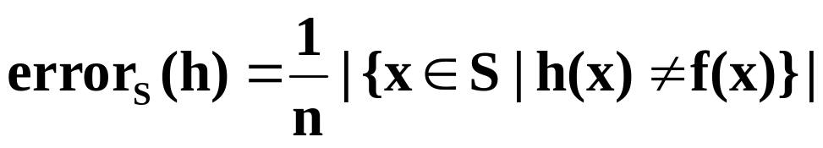
Estimating Hypothesis Accuracy
The property we are interested in is (for some fixed function f)
The True Error:
Since we cannot observe it, we are performing an experiment:
we collect a random sample S of n independently drawn instances from
the distribution D, and use it to measure
The Sample Error:
Naturally, each time we run an experiment (i.e., collect a sample of
n test examples) we expect to get a different Sample Error.

Slide 10


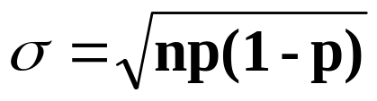
Estimating Hypothesis Accuracy
The distribution of the number of mistakes is Binomial( p) with
p=
The mean is
and the standard variation is

Slide 11
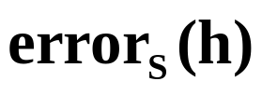
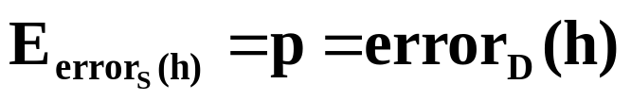
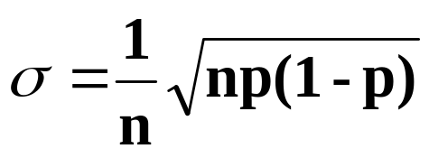
Estimating Hypothesis Accuracy
The Sample Error is distributed like
r/n, when r is Binomial(p)
The mean is
and the standard variation is

Slide 12
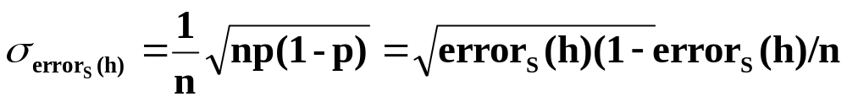
Estimating Hypothesis Accuracy
The Sample Error is distributed like r/n, when r is Binomial(p)
The mean is
and the standard variation is ,
But, due to the central limit theorem, if n is large enough (30…)
we can assume that the distribution of the Sample Error is Normal
with mean
and standard variation:

Slide 13
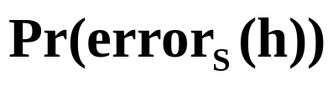
Estimating Hypothesis Accuracy
The distribution of the Sample Error:
Consequently, one can give a range on the error of a hypothesis such
that with high probability the true error will be within this range.

Slide 14
Estimating Hypothesis Accuracy
The distribution of the Sample Error:
Consequently, one can give a range on the error of a hypothesis such
that with high probability the true error will be within this range.
Given the observed error (your estimate of the true error), you know
with some confidence that the true error is within some range around it.

Slide 15
Some Numbers
Assume you test an hypothesis h and find that it commits
r = 12 errors on a sample of n=40 examples.
The estimation for the true error will be: p=r/n= 0.3
What is the variance of this error ?
(n is fixed, r - random variable, distributed Binomial(0.3).)
Therefore σ(# of mistakes) = √40. 0.3 (1-0.3) = 2.89
And σ(sample error) = 2.89/40=0.07
r = 300 errors on a sample of n=1000 examples.
The estimation for the true error will be: p=r/n= 0.3
And σ(sample error) = √ 0.3 (1-0.3)/1000=14.5/1000=0.014

Slide 16
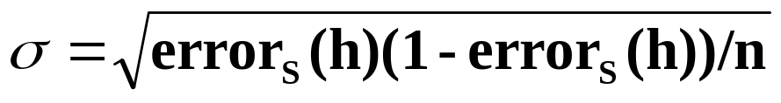
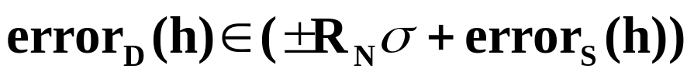
Estimating Hypothesis Accuracy
The distribution of the Sample Error:
95% of the samples are within
±2σ of the mean
Consequently, one can give a range on the error of a hypothesis such
that with high probability the true error will be within this range.
With confidence N%:
Confidence N% 50% 68% 80% 90% 95% 98% 99%
Constant R 0.67 1.00 1.28 1.64 1.96 2.33 2.58

Slide 17
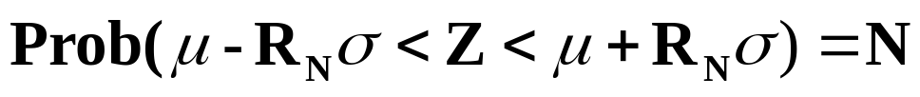
Estimating Hypothesis Accuracy
The distribution of the Sample Error:
95% of the samples are within
±2σ of the mean
Consequently, one can give a range on the error of a hypothesis such
that with high probability the true error will be within this range.
With confidence N%:
Confidence N% 50% 68% 80% 90% 95% 98% 99%
Constant R 0.67 1.00 1.28 1.64 1.96 2.33 2.58

Slide 18
Comparing Two Hypotheses
When comparing two hypotheses, the ordering of their sample accuracies
may or may nor accurately reflect the ordering of their true accuracies.

Slide 19
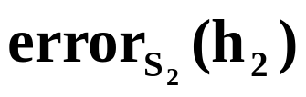
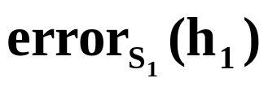





Comparing Two Hypotheses
When comparing two hypotheses, the ordering of their sample accuracies
may or may nor accurately reflect the ordering of their true accuracies.
Interpretation: assume we test on and on and measure
and respectively. These graphs indicate the
probability distribution of the sample error. We can see that it is possible
that the true error of is lower than that of and vice versa.

Slide 20
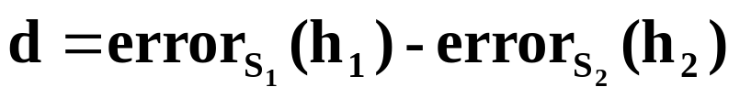



Comparing Two Hypotheses
We wish to estimate the difference between the true error of these
hypotheses.
The difference of two normally distributed variables is also normally
distributed

Slide 21
Comparing Two Hypotheses
We wish to estimate the difference between the true error of these
hypotheses.
The difference of two normally distributed variables is also normally
distributed
Notice that the density function is a convolution of the original two

Slide 22

Confidence in Difference
The probability that is the probability
that d > 0 which is given by the shaded area.

Slide 23
Confidence in Difference
Since the normal distribution is symmetric, we can also assert
confidence intervals with lower bounds and upper bounds

Slide 24
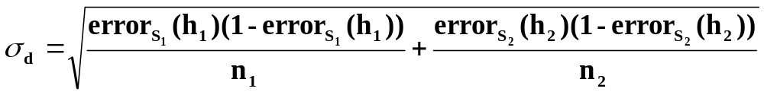
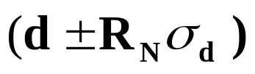
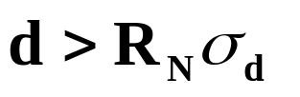
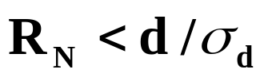
Standard Deviation of the Difference
The variance of the difference is the sum of the variances
The mean is the observed difference d
Therefore, the N% confidence interval in d is
What is the probability that ?
This is the confidence that d is in the one-sided interval d >0
We find the highest value N such that , that is
and conclude that
with probability (100-(100-N)/2)%

Slide 25
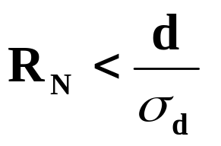
Standard Deviation of the Difference
What is the probability that ?
This is the confidence that d is in the one-sided interval d >0
We find the highest value N such that , that is
and conclude that
with probability (100-(100-N)/2)%
Confidence N% 50% 68% 80% 90% 95% 98% 99%
Constant Rn 0.67 1.00 1.28 1.64 1.96 2.33 2.58

Slide 26
Hypothesis Testing
A statistical hypothesis is a statement about a set of parameters of a distribution. We are looking for procedures that determine whether the hypothesis is correct or not.
In this case we can say that we accept the hypothesis that
with N% confidence.
Equivalently, we can say that we reject that hypothesis that the
difference is due to random chance,
at a (100-N)/100 level of significance.
By convention, in normal scientific practice, a confidence of 95%
is high enough to assert that there is a “significant difference”.

Slide 27
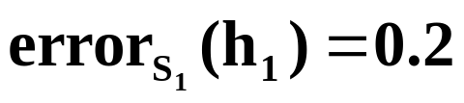
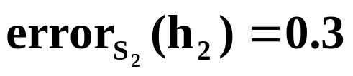
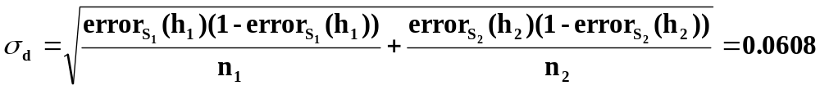
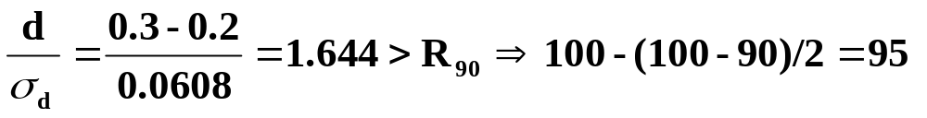
A Hypothesis Test
Assume that based on two different samples of 100 test instances
we observe that:
We can say that we accept the hypothesis that “h1 is better than h2”
with 95% confidence, or that the difference is significant at the .05 level.

Slide 28


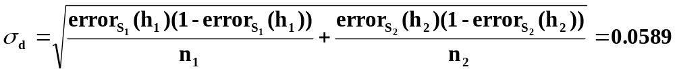
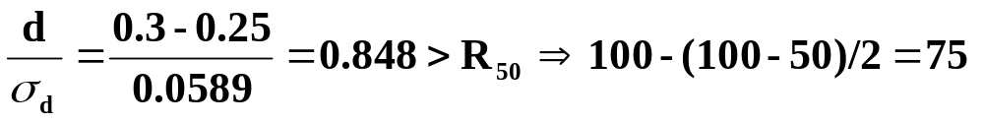
A Hypothesis Test
Assume that based on two different samples of 100 test instances
we observe that:
We conclude: “h1 is better than h2” with 75% confidence.
Cannot conclude that that difference is significant (since p> .05).

Slide 29
Comparing Learning Algorithms
Given two algorithms A and B we would like to know which of the
methods is the better method, on average, for learning a
particular function f
Statistical tests must control several sources of variation:
- variation in selecting test data
- variation in selecting training data
- random decisions of the algorithms
Algorithms A might do better than B when trained on a particular
randomly selected set, or when tested on a particular randomly
selected test set, even though on the whole population they
perform identically.

Slide 30
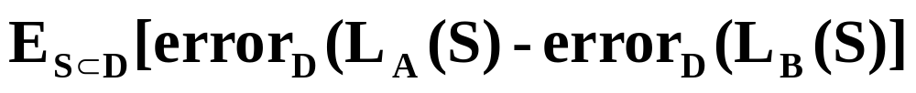
Comparing Learning Algorithms
An ideal statistical test should derive conclusions based on estimating:
where by L(S) we denote the output hypothesis of the algorithm
when being trained on S, and the expectation is over all possible
samples from the underlying distribution, taken independently.
In practice we usually have a sample D’ from D to work with.
The average is therefore done on different splits of this sample
to training/test sets.
We want methods that
- identify a difference between algorithms when it exists
- do not find a difference when it does not exists

Slide 31
Methodology
Assume a hypothesis (null hypothesis)
E.g. the algorithms are equivalent
Choose a statistics
A figure that you can compute from the data and can estimate given
that the hypothesis holds.
- what value do we expect? (assuming the hypothesis holds)
- what value do we get? (experimentally)
What is the probability distribution of the statistics?
What’s the deviation of the empirical figure from the expected one?
Decide: Is this due to chance?
- Yes/ No/ with what confidence?

Slide 32
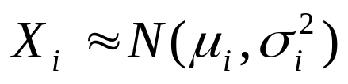

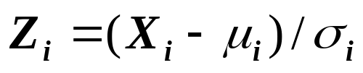
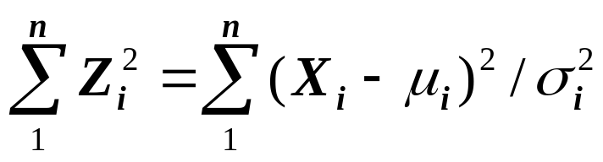
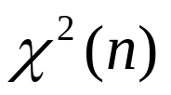
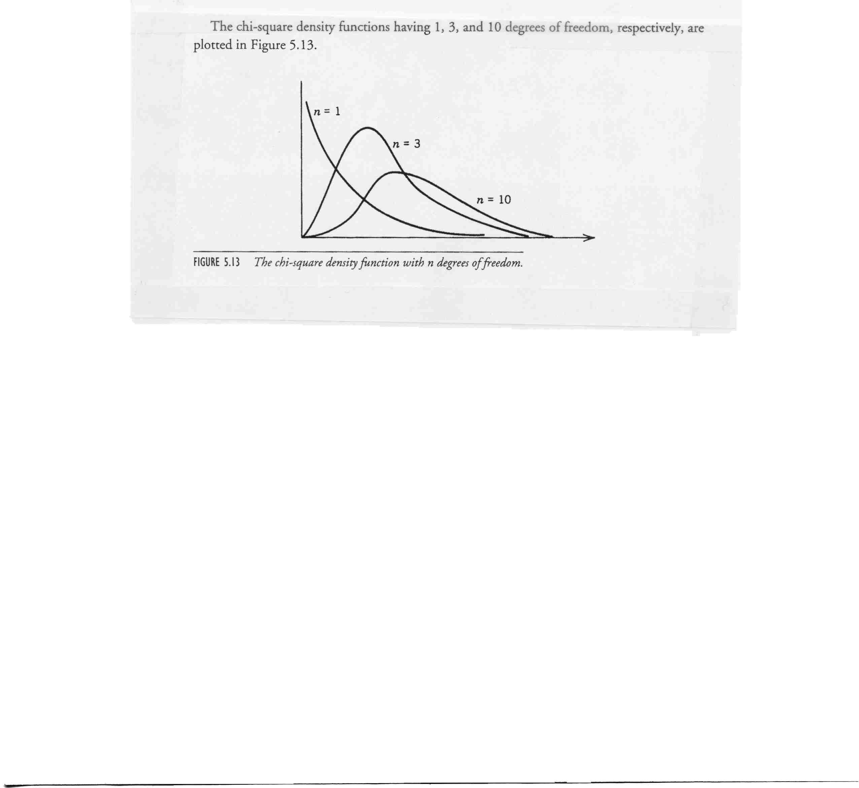
Distributions
Normal Distribution
Chi Square
Consider the random variables:
The random variables defined by:
is (with n degrees of freedom)

Slide 33
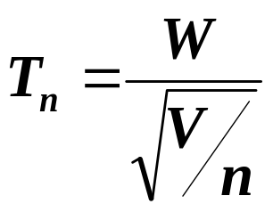
Distributions
Student’s t distribution:
Let W be N(0,1), V be and assume the W,V are independent
Then, the distribution of the random variable
is call a t-distribution (with n degrees of freedom)
Tn is symmetric about zero.
As n becomes larger, it becomes more and more like N(0,1).
E(Tn) = 0 Var(Tn) = n/(n-2)

Slide 34
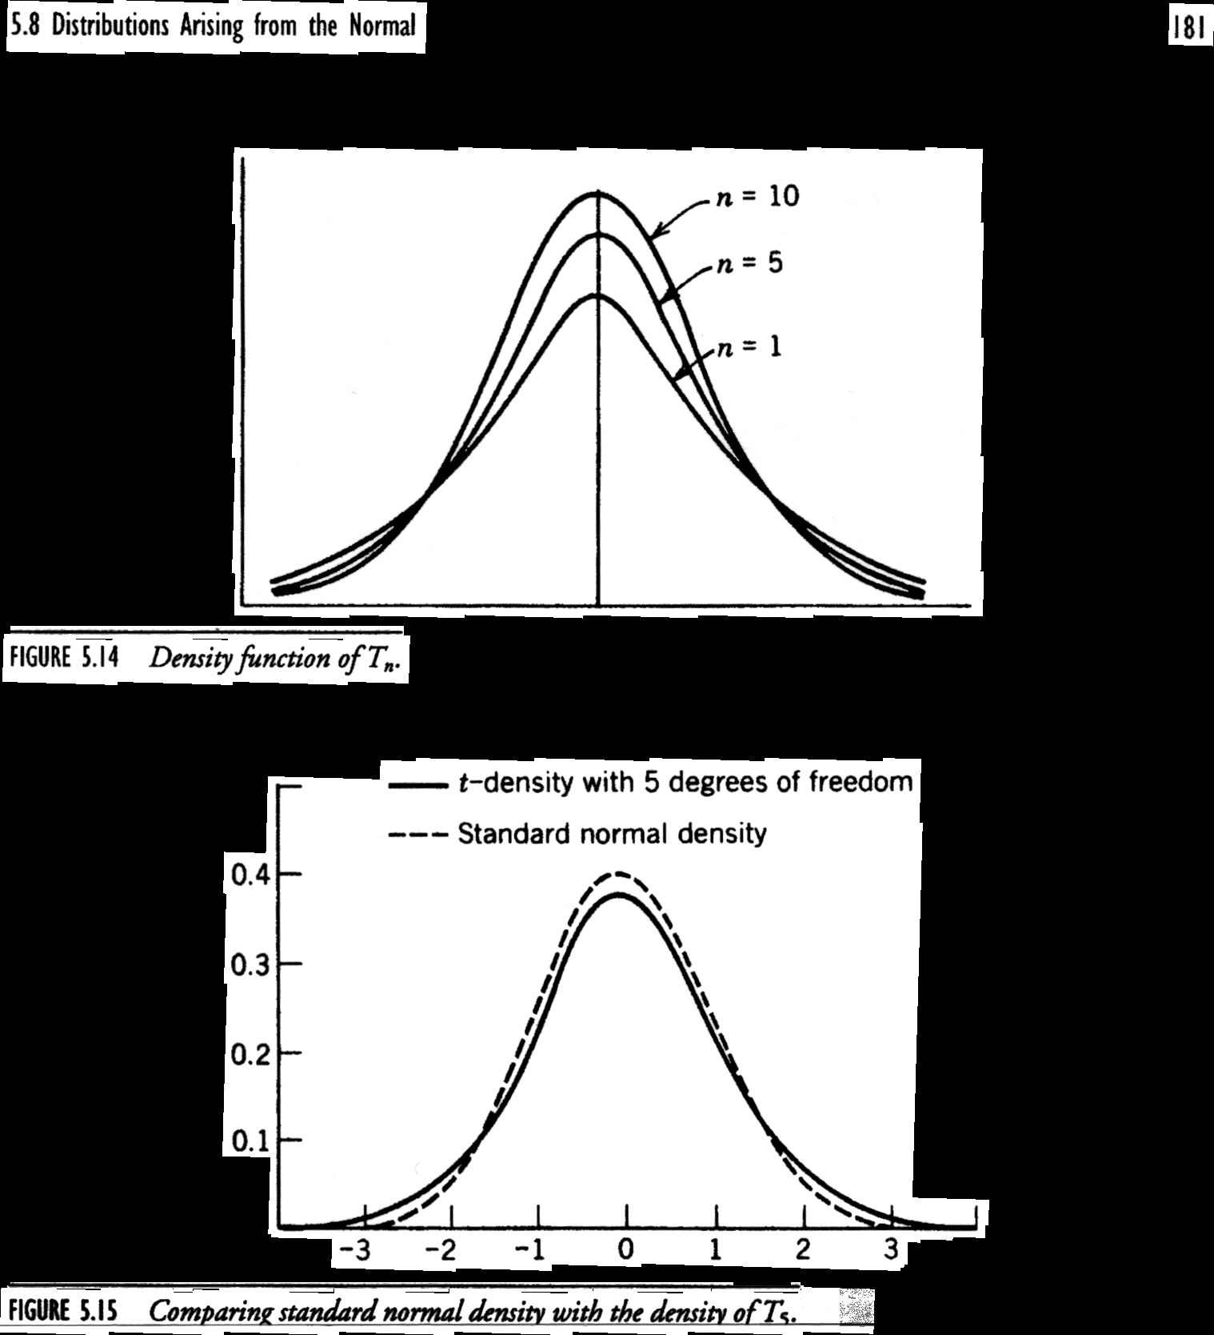
t-Distributions
Student’s t distribution:
Let W be N(0,1), V be and assume the W,V are independent
Then, the distribution of the random variable
is call a t-distribution (with n degrees of freedom)
Tn is symmetric about zero.
As n becomes larger, it becomes more and more like N(0,1).
E(Tn) = 0 Var(Tn) = n/(n-2)

Slide 35
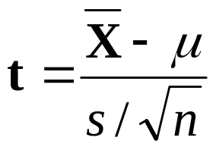
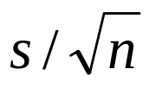
t Distributions
Originally used when one can obtain an estimate for the mean
but not for σ
We want a distribution that allows us to compute a confidence
in the mean μ without knowing σ , but only an estimate s for it
(based on the same sample that produced the mean).
The quantity t is given by:
That is, t is the deviation of the sample mean from the population
mean, measured in units of the means standard error
This is good for small samples, and the tables depend on n

Slide 36





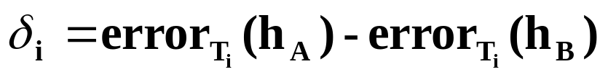
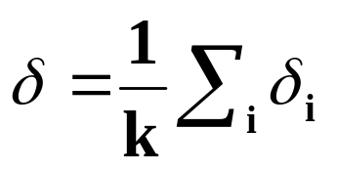
K-Fold Cross Validation
Partition the data D’ into k disjoint subsets of
equal size.
For i from 1 to k do:
Use for test and the rest for training.
Set
Return the average difference in error:

Slide 37
K-Fold Cross Validation Comments
10 is a standard number of folds.
When k=|D|, the methods is called leave-one-out.
Every example gets used as a test example exactly once and
as a training example k-1 times.
Test sets are independent but training set overlap significantly.
The hypotheses are generated using (k-1)/k of the training data.

Slide 38
K-Fold Cross Validation Comments
10 is a standard number of folds.
When k=|D|, the methods is called leave-one-out.
Every examples gets used as a test example exactly once and
as a training example k-1 times.
Test sets are independent but training set overlap significantly.
The hypotheses are generated using (k-1)/k of the training data.
Before we compared hypotheses using independent test sets.
Here, the hypotheses generated by algorithms A and B are tested
on the same test set (paired tests).

Slide 39
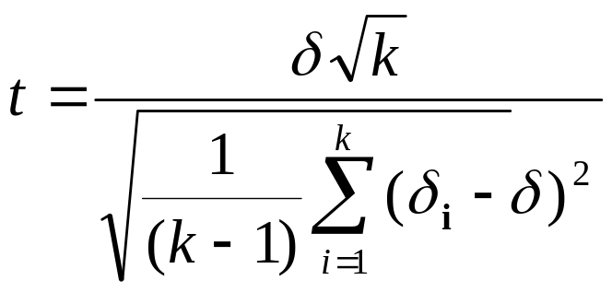

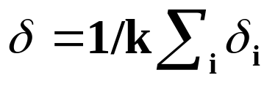
Paired t Tests
Paired tests produce tighter bounds since any difference is due to
difference in the hypotheses rather than differences in the test set.
Significance Testing of the Paired Tests:
Compute the statistics:
where is the measured difference between A and B on the
ith data set and is their average.
The statistics is distributed according to a t-distribution(k)
When k paired test are performed
With k=30, to get N=95%, we need |t| < 2.04

Slide 40
Paired t Tests
Paired t tests can be used in many ways.
Sample the data 30 times.
Split each sample to Train and Test.
Run A and B on Train and Test. Let be the difference in error.
Estimate the same statistics.
(Most common in Machine Leaning; has problems)
10-Fold Cross validation:
The ith experiment is done on
Better; has problems due to training set overlap

Slide 41

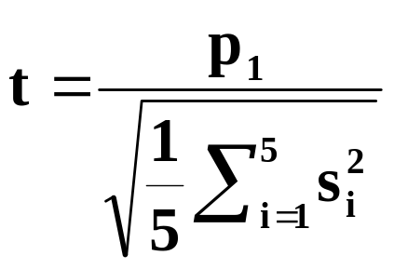
5x2 Cross Validation
Perform 5 replication of 2-fold cross validation.
In each replication, the available data is randomly partitioned into
and of equal size.
Train algorithms A and B on each set and test on the other.
Error measures:
Let be the variances computed for each of the 5 replications.
Then,
Has a t-distribution, with k=5

Slide 42
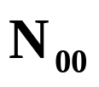
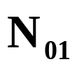
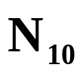

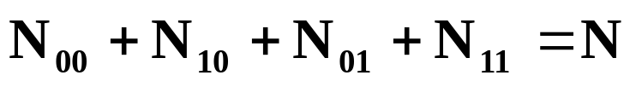
McNemar’s Test
An alternative to Cross Validation, when the test can be run only once.
Divide the sample S into a training set R and test set T.
Train algorithms A and B on R, yielding classifiers A, B
Record how each example in T is classified and compute the number of:
examples misclassified by both examples misclassified by
A and B A but not B
examples misclassified by both examples misclassified by
B but not A neither A nor B
where N is the total number of examples in the test set T

Slide 43
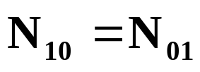
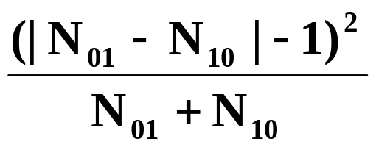
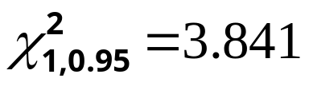
McNemar’s Test
The hypothesis: the two learning algorithms have the same error rate
on a randomly drawn sample. That is, we expect that
The statistics we use to measure deviation from the expected counts:
This statistics is distributed (approximately) as with 1 degree
of freedom. (with a continuity correction since the statistics is discrete)
Example: Since we reject the hypothesis with
95% confidence if the above ratio is greater the 3.841

Slide 44
Experimental Evaluation - Final Comments
Good experimental methodology, including statistical analysis is
important in empirically comparing learning algorithms.
Methods have their shortcomings; this is an active area of research.
Tom Dietterich, Approximate statistical tests for comparing supervised
classification learning algorithms (Neural Computation)
Artificial data is useful for testing certain hypotheses about specific
strength and weaknesses of algorithms but only real data can test
the hypothesis that the bias of the learner is useful for the actual
problem.
There are a few benchmarks for comparing learning algorithms.
The UC Irvine repository is the one most commonly used
http://www/ics.uci.edu/mlearn/MLRepository.html

